Slide 1
BackLog Tracker
By Peace Pandas
AKA the P.P. Boys
Notes:
Introduce ourselves! Say names of our team!

Slide 2
Contributions:
GUI Design - Kyle, Noah
User Experience - Alessandro, Noah
Login - Noah, Kyle
Signup - Noah
Update Table - Kyle, Alessandro
Add Entry - Alessandro
Edit Entry - Alessandro
Delete - Kyle
SQL Connection - Kyle, Noah, Alessandro
Presentation Slides - Kyle, Alessandro, Noah
Presenting - Alessandro, Noah, Kyle
Notes:
Don't change! It's perfect! clear and concise contributions to the project! Keep it short and sweet!

Slide 3
What is the Game Backlog Tracker all about?
Content
Potential Audience
A humble user interface with simple functionality
Users can sign up and login to their account to access their own private lists of games
Users can add to and interact with their lists
Presents user with their current progress in the backlog of games
Avid video gamers!
Steam users!
And more!
Such as fans of list making!
Purpose
To help those who have games that they wish to play
And assist users in visualizing their progress!
Notes:
Coding valhalla awaits us - alex

Slide 4
Demonstration!
Notes:
Let us know if you need an assist mid demo! Check database after each button functionality is shown

Slide 5
All about that GUI!
“Why does it look like that?”
Most intuitive design for all of us; no discussion, instant agreement
Simple and distinct labels
Minimal and reusable buttons and inputs
Minimal and compact window design
All functions on one page
Active, engaging feedback through basic dialog boxes
Notes:
Talk about how all these things are innovative somehow and good for the user! It’s all with the user in mind! Because we are in a way a part of the intended audience for users! Also more intuitive to have dialog box for the edit function because a user won't instinctively know to use the single text entry space a second time to rename the game without being prompted

Slide 6
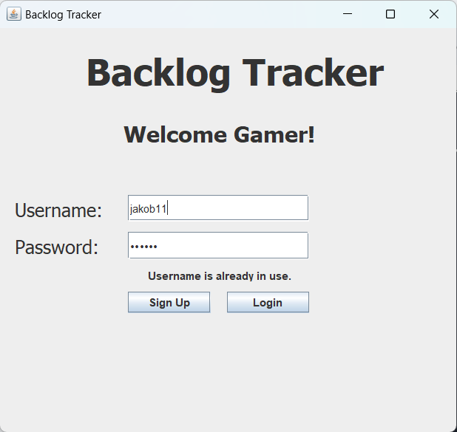
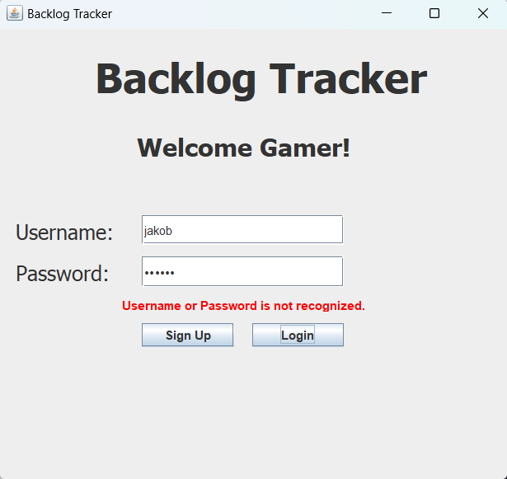
First portal options:
Login
Sign Up
Access to the User’s backlog tracker
If password is wrong an error message will display
Creation of new User and relative table
If user already exists an error message will display
Notes:
Database design is exceptionally well-explained, demonstrating scalability, security, and performance considerations

Slide 7
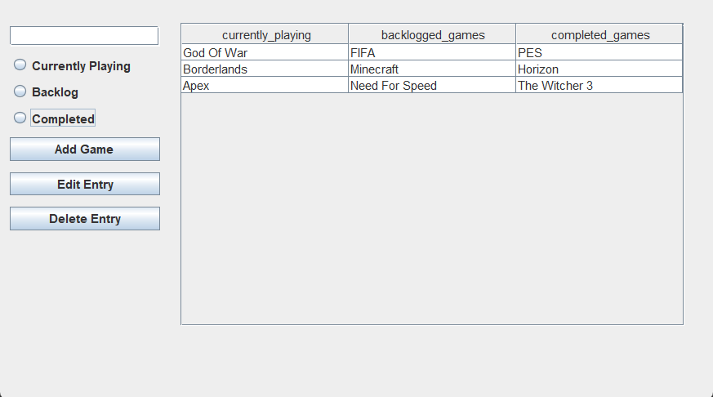
Second portal options:
Three lists to help keep track of your games:
Current
Backlogged
Completed
Three actions to edit those lists:
Add
Edit
Delete
Notes:
Elaborate on the main functions of the project, explaining the logic and algorithms behind them. (Add, Edit, Delete and interconnection with
Current backlogged and completed)

Slide 8
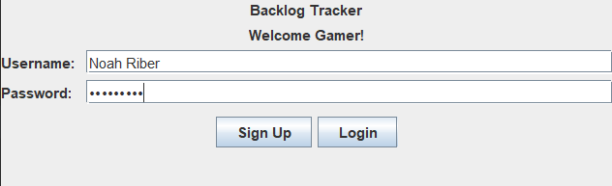
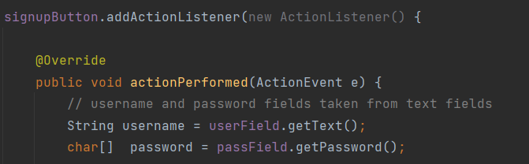
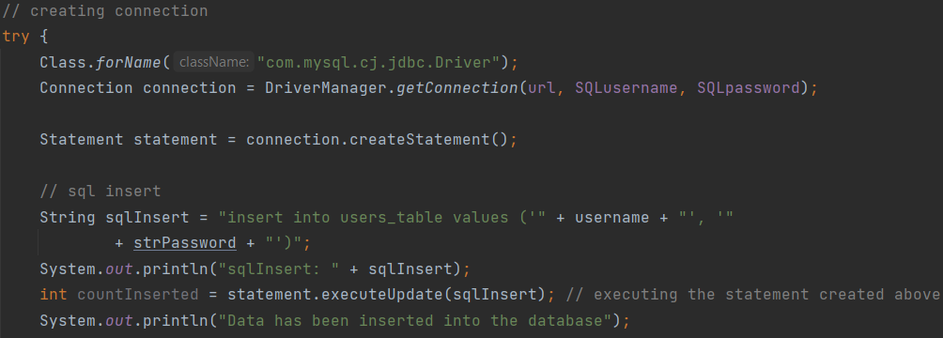
Collaboration of Components
“How does it work?”
GUI -> Functions -> SQL
ActionListenerEvent tied to JButtons on the GUI Connection made to SQL database in each ActionListenerEvent
Data injection tied to text fields in the GUI
Data validation and personalization based on which user logs in
Notes:
Talk about how all these things are innovative somehow and good for the user! It’s all with the user in mind! Because we are in a way a part of the intended audience for users! Also more intuitive to have dialog box for the edit function because a user won't instinctively know to use the single text entry space a second time to rename the game without being prompted

Slide 9
Quick Segment!
(A unique approach to a minor challenge)
To combat this, our ADD button now checks for blank spots to fill in first!
Delete button:
DELETE in sql actually deletes entire rows
Big no no!
Opted to use UPDATE and SET entry to NULL
Thus no need for new tables for each list!
DELETE led to
tables like this →
After using the UPDATE method,
Tables would look kinda…
Game B | Game 2 | Game A
Game 4 | Game 5 | Game C
Game 7 | Game D | Game E
Game 10 | Game 11 | Game 12
Game F
(Result if Game 1, 3, 6, 8, and 9 were deleted)
 | Game 2
Game 4 | Game 5
Game 7
Game 10 | Game 11 | Game 12
Game 4 | Game 5 | Game 6
Game 10 | Game 11 | Game 12
(Result if Game A, B, C, D, E, and F were added to the different lists)
Awful!
Irrational!!
Repulsive!!!
Amazing!
Normal!!
As intended!!!
(Result if Game 1 and Game 9 were deleted)
Code snippet to demonstrate us using the update function

Slide 10
Strengths and Weaknesses and Strategies
No tutorial, manual, or directions for user
Not fully optimized GUI/UX
Not the prettiest GUI
Doesn’t do much to actually motivate user, relies entirely on intrinsic motivation
Only 3 lists available
Not very innovative, not a lot of room to innovate with current scope
Display more precise directions for the user with labels and such
Research ways to reduce number of clicks. Streamline interaction like typing into table itself
Take the time to make it prettier!
Take more user info (email/phone#) to implement a reminder message system. Give positive reinforcement after game completion, ‘gamify’ the program
Give user way to add columns, example is for a “Favorites” list
Would need time and research to find ways to make service truly unique and innovative
Great for making three step completion based lists for any subject, if one can ignore the labels (such as a heavily watered down version of Kanban!)
Simple, easy to use
Efficient, quick, succinct
Notes:
If anyone thinks of another strength pls add it, We could use more even if its kinda bs lol

Slide 11
Questions?

